Slide 1

Property Evaluation in
New York City
File created on: 7/29/2019 2:14:31 PM

Slide 2
Objectives
Two prediction tasks:
1. Value of the Land (no building)
2. Value of the property (land + building)

Slide 3
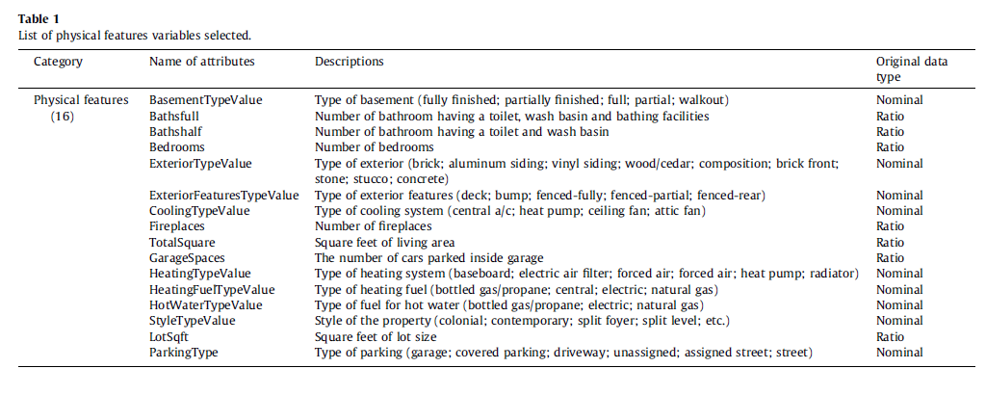
Previous studies
Using machine learning algorithms for housing price prediction:
The case of Fairfax County, Virginia housing data;
Byeonghwa Park a, Jae Kwon Bae

Slide 4
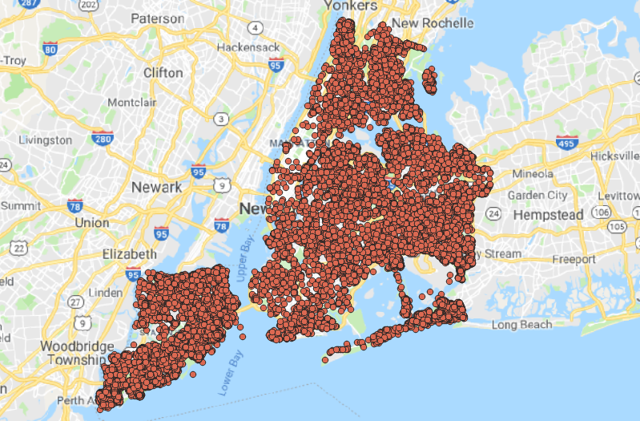
The Data

Slide 5
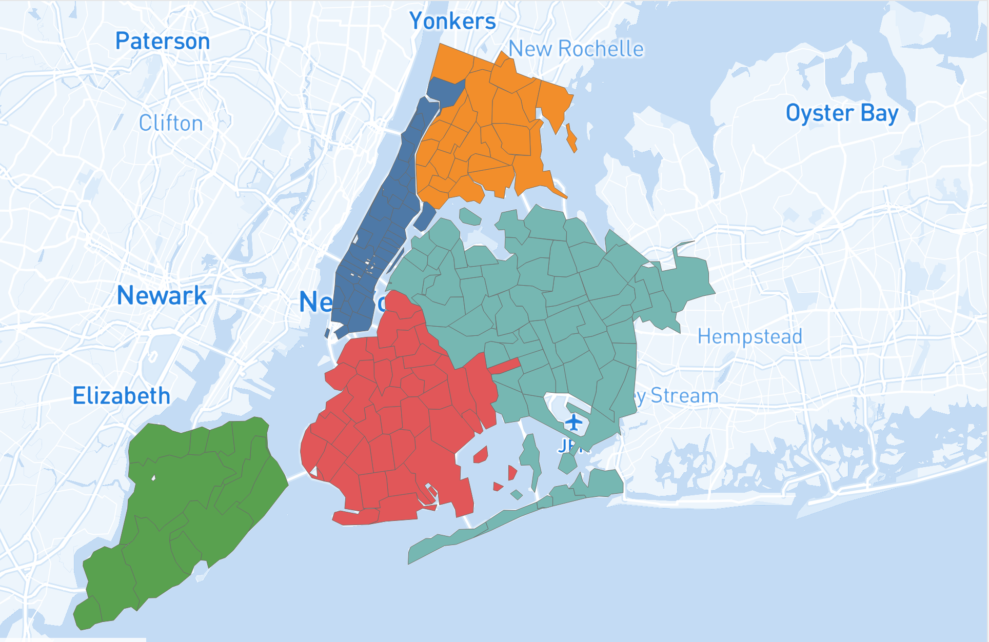
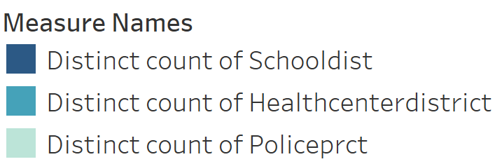
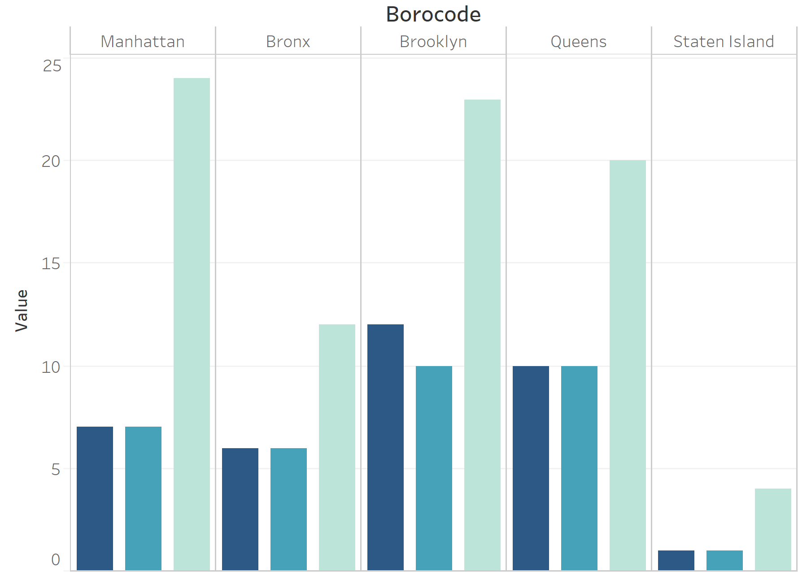
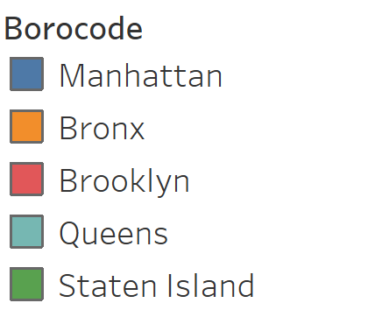

Slide 6
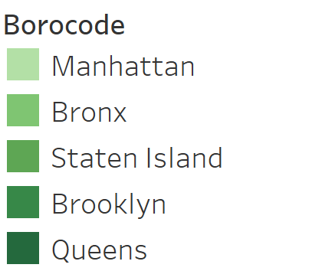
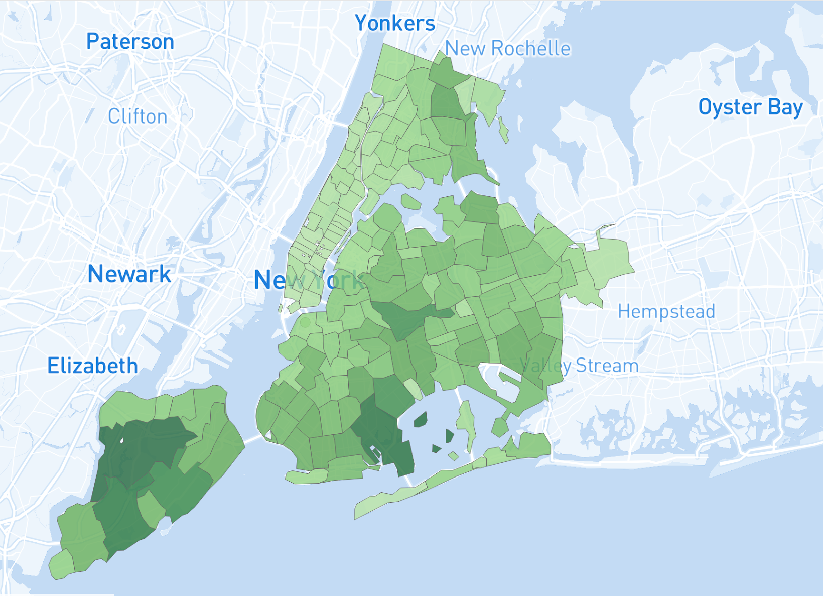
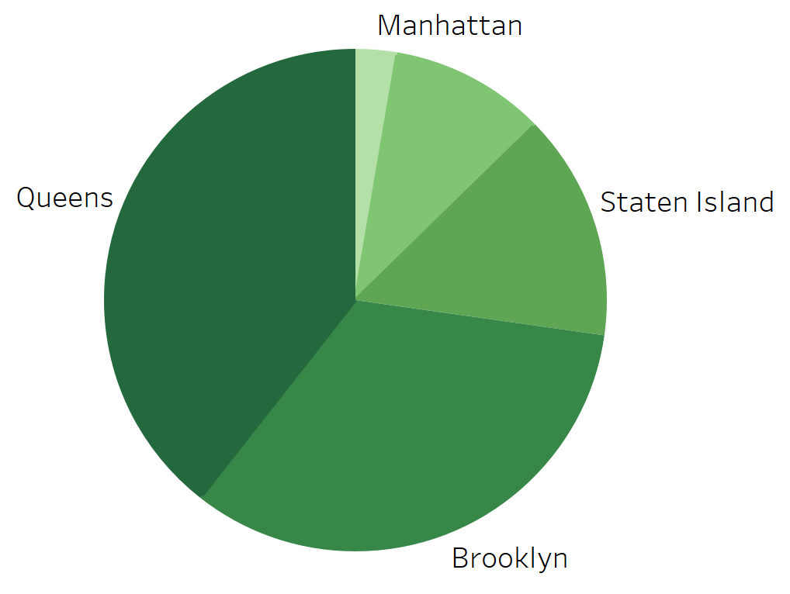
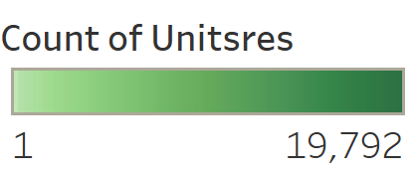

Slide 7
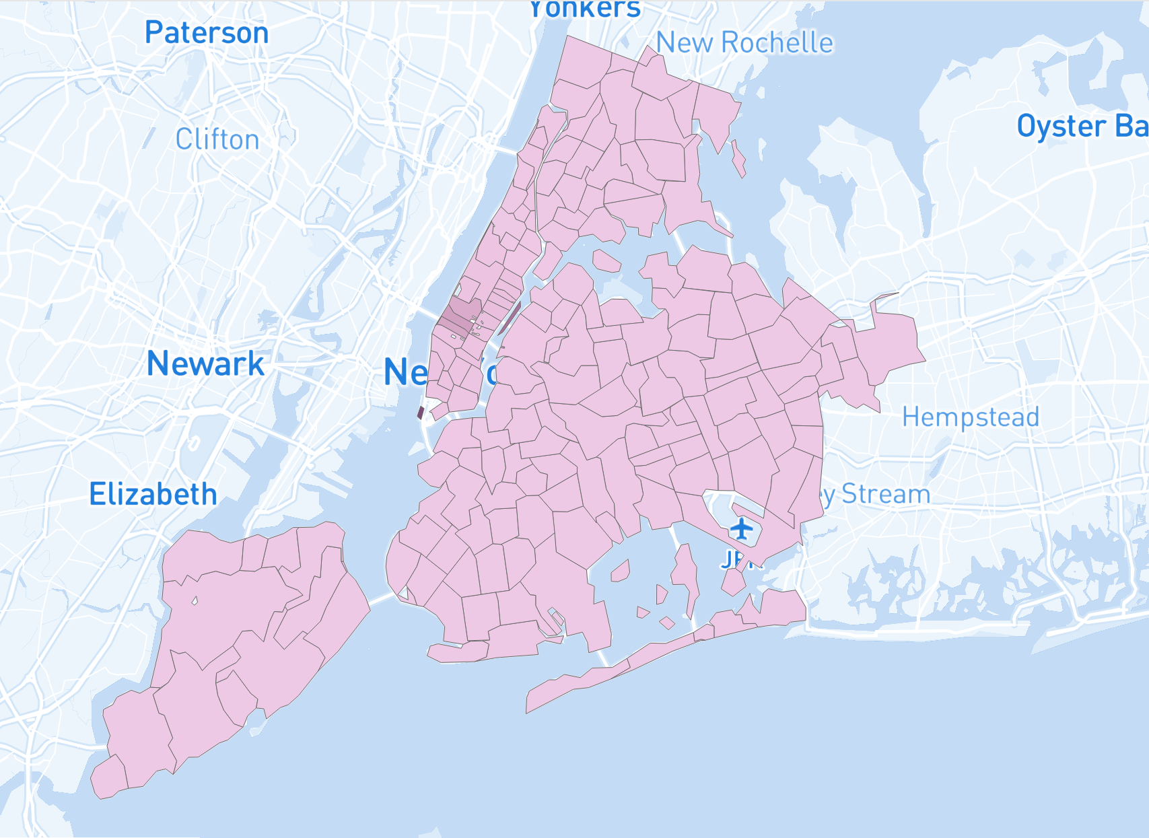
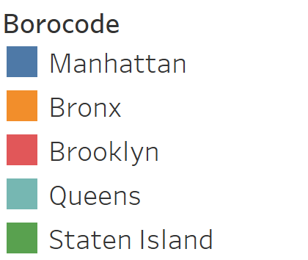
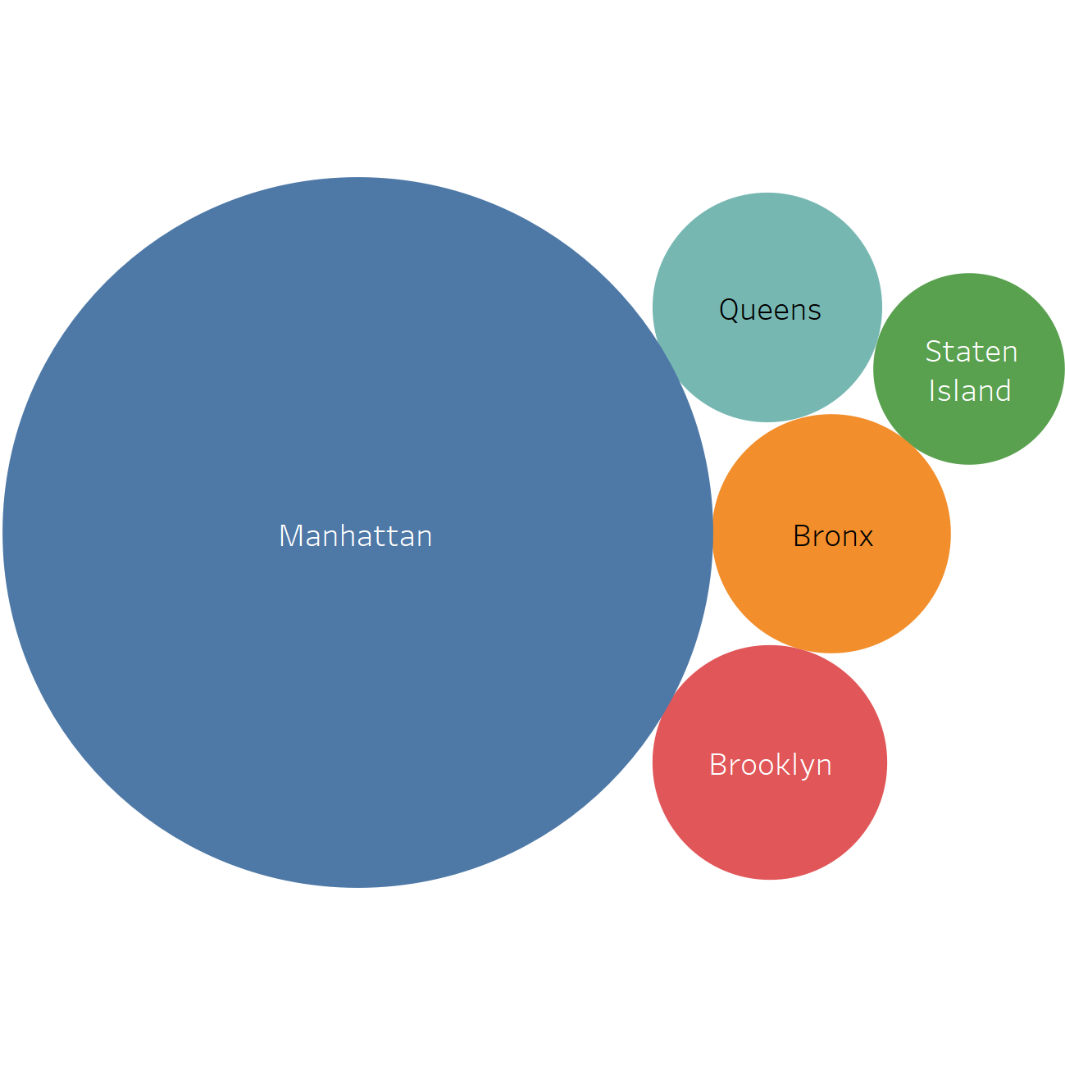
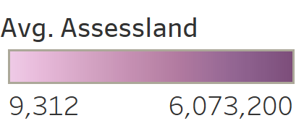

Slide 8
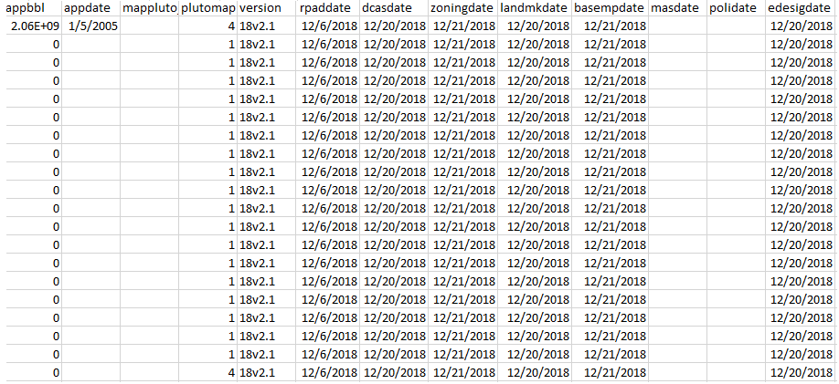
Data Cleaning

Slide 9
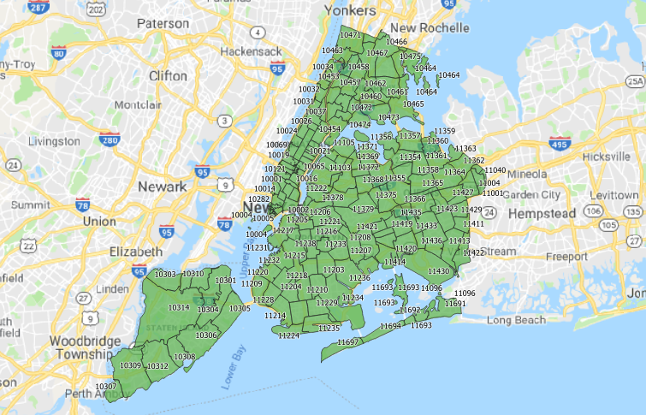
Fixing Data - Zip Codes

Slide 10
Data Modeling
Ridge Regression
Lasso Regression
KNN
Random Forest
Neural Network

Slide 11
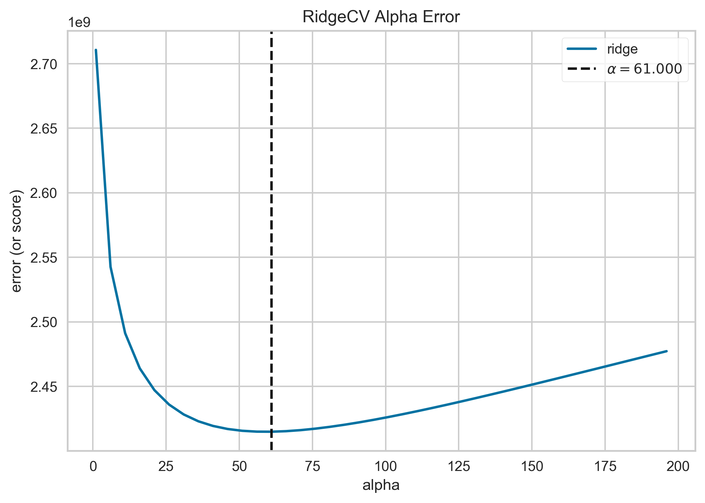
Ridge Regression

Slide 12
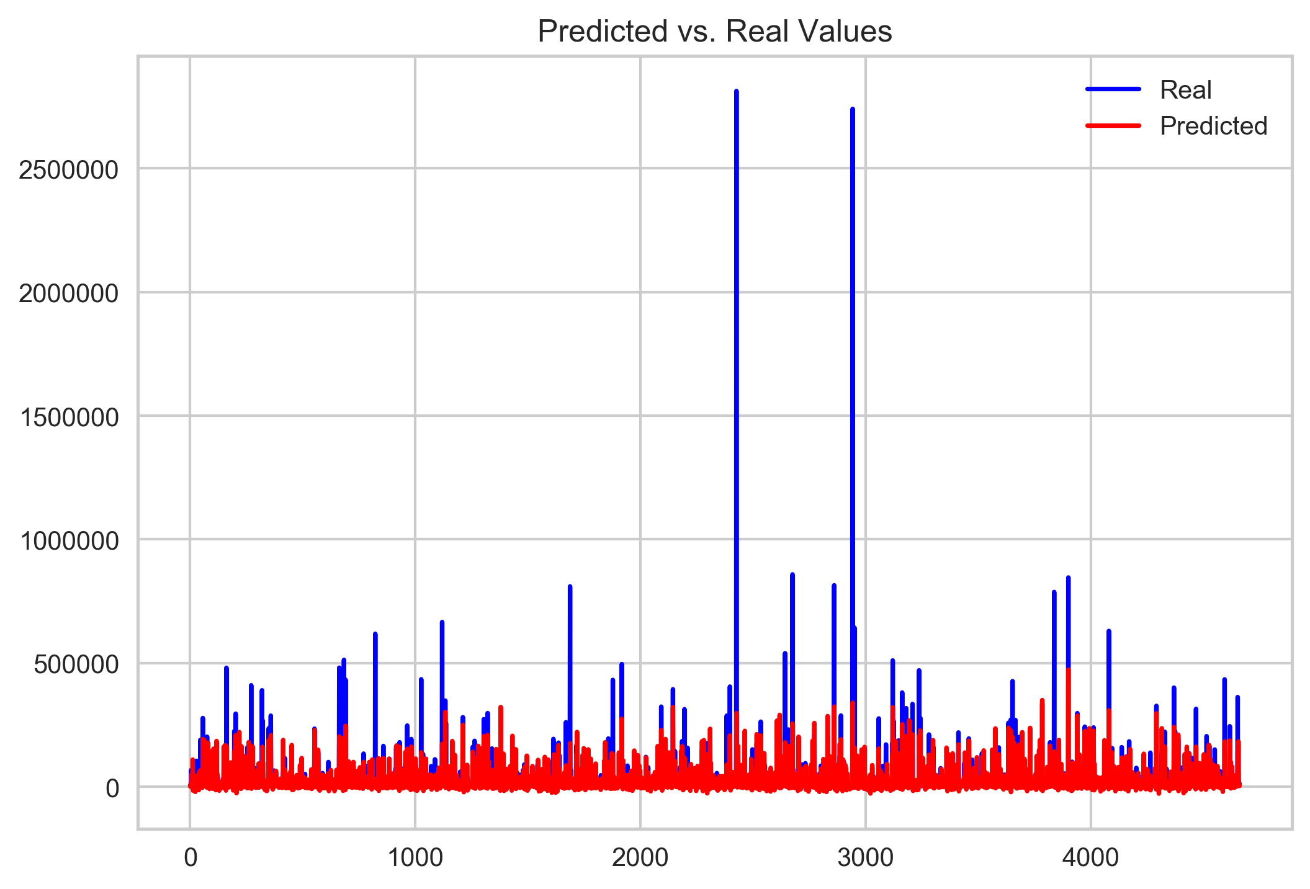
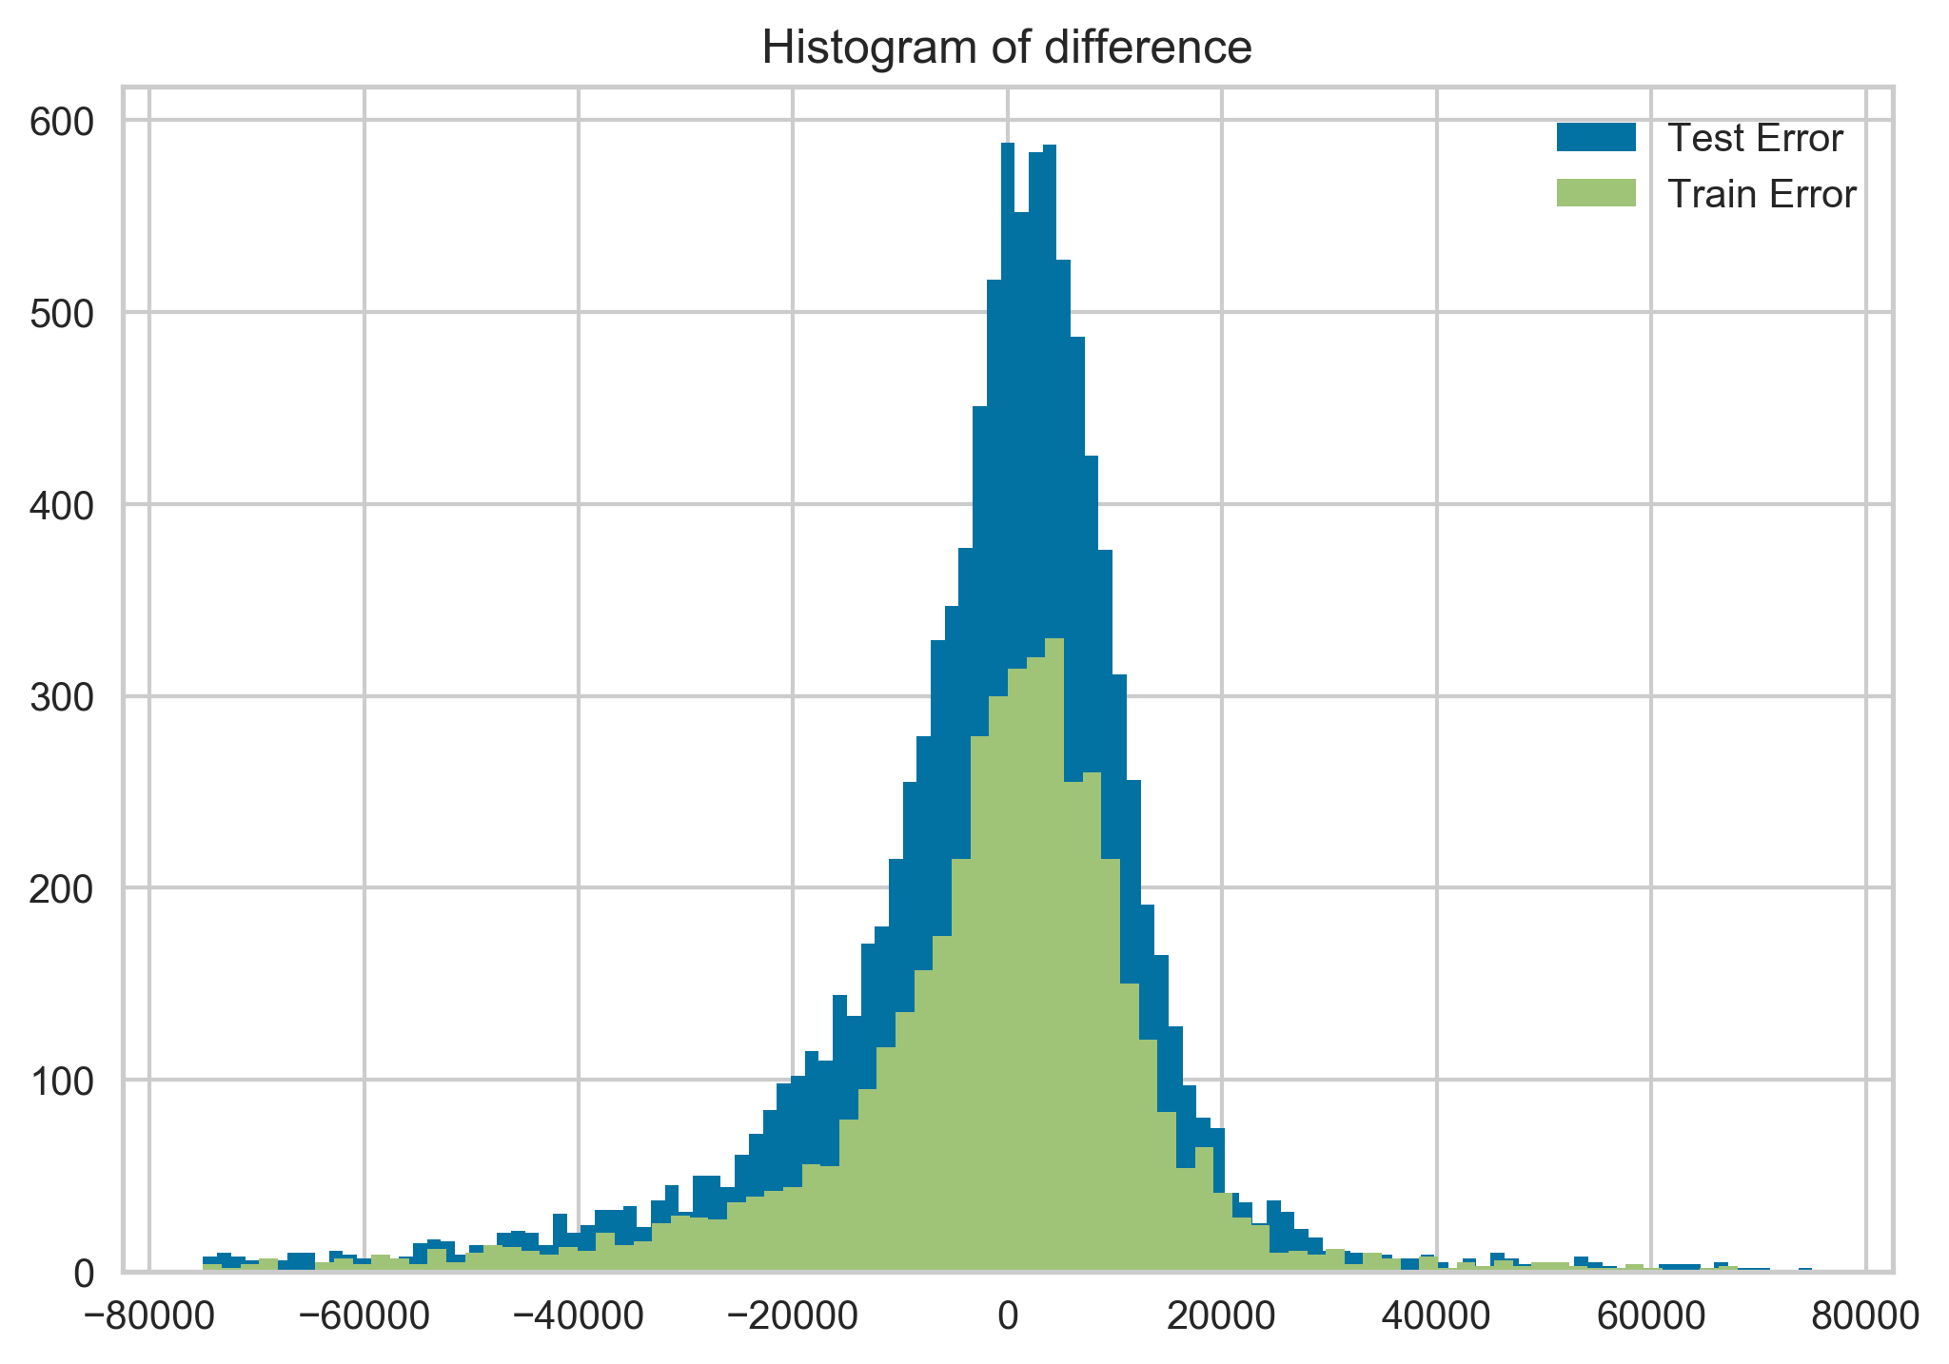
Ridge Regression

Slide 13
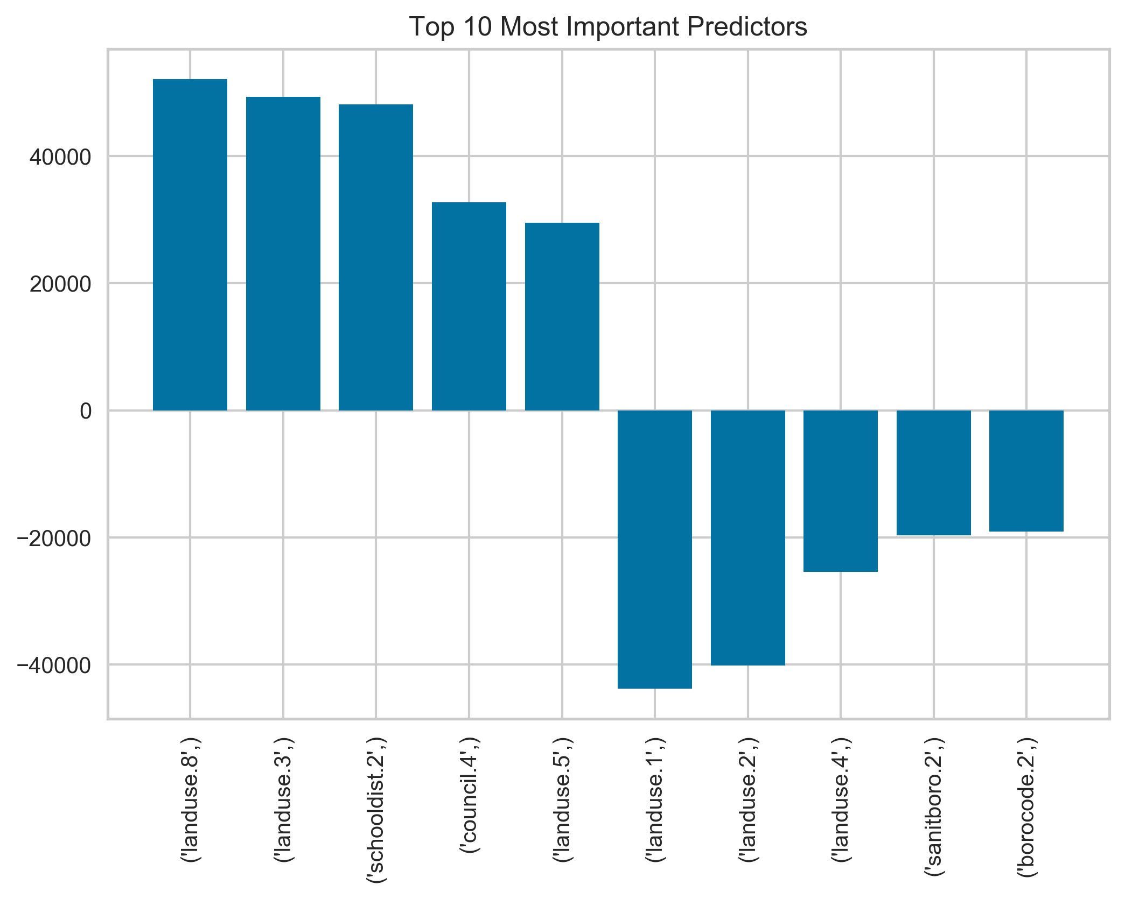
Ridge Regression

Slide 14


Lasso Regression

Slide 15
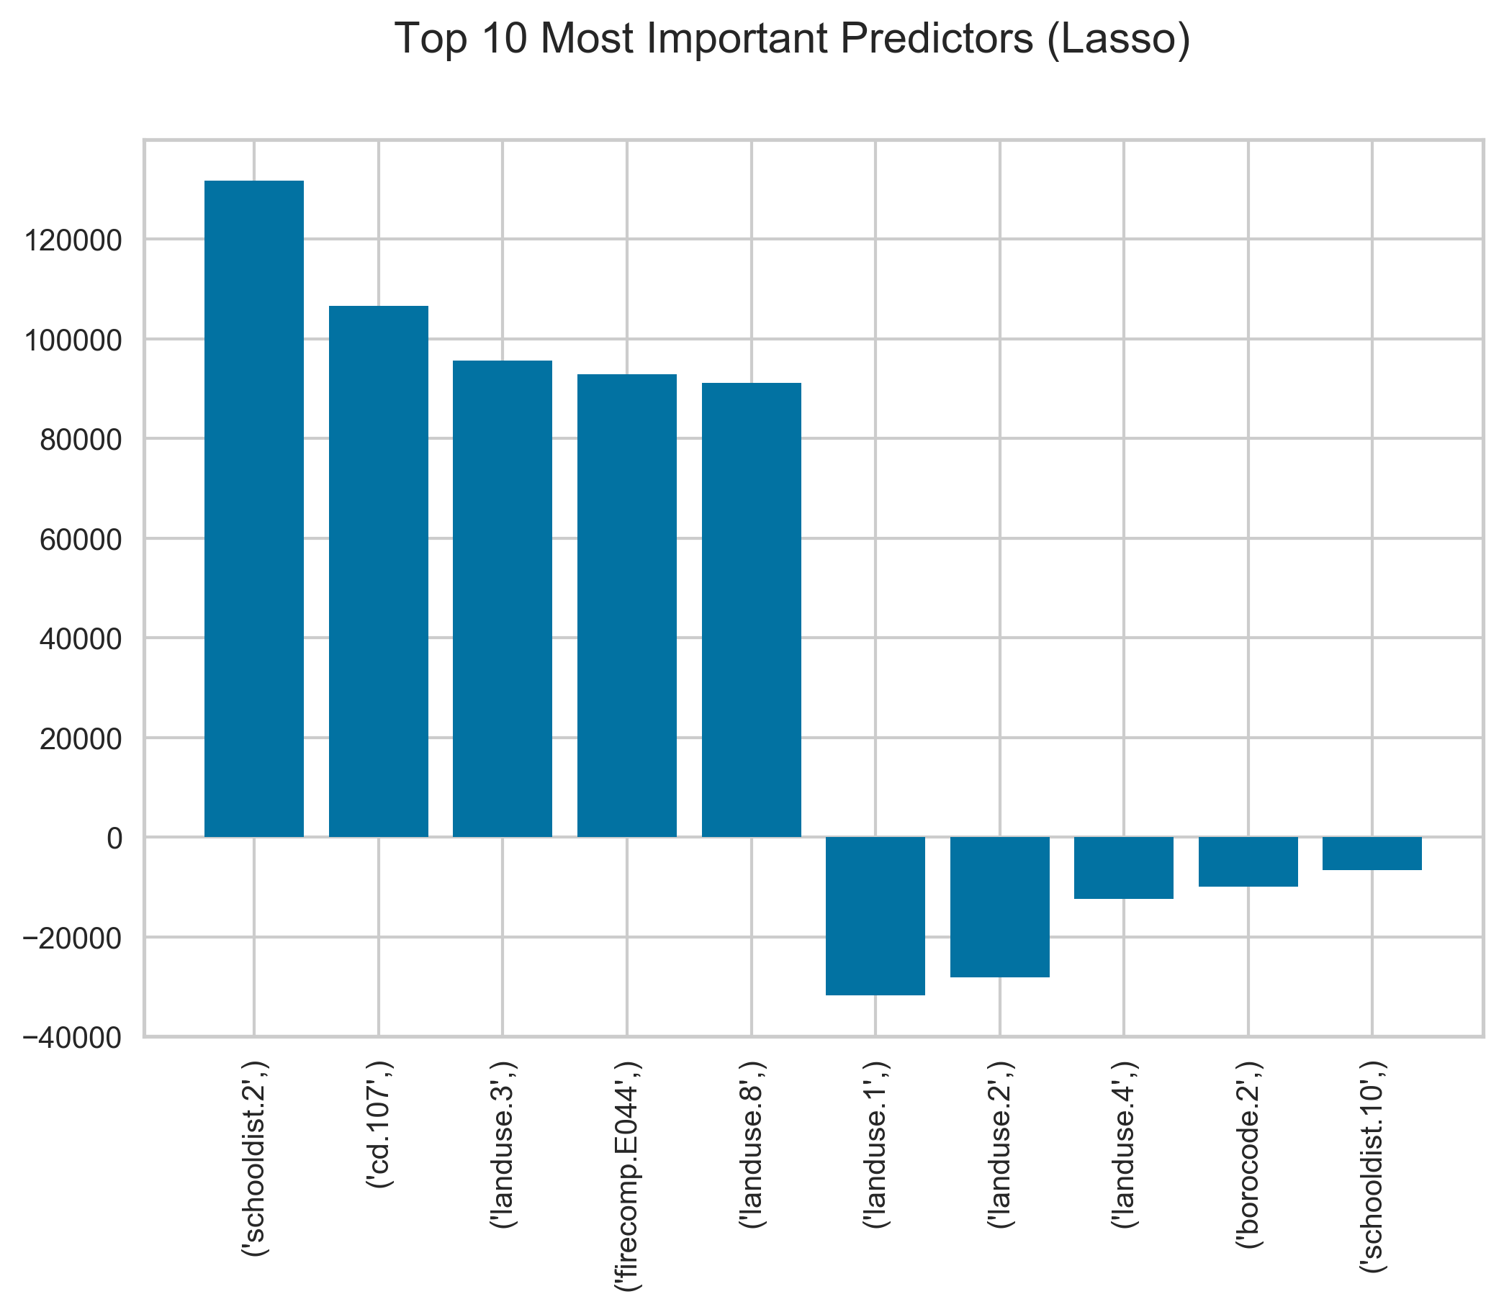
Lasso Regression

Slide 16
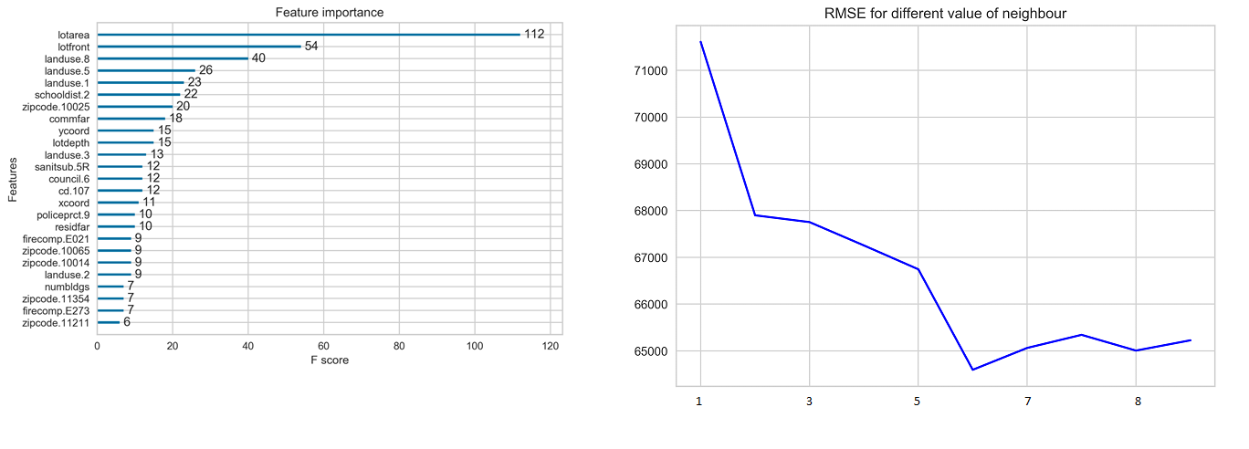
KNN

Slide 17
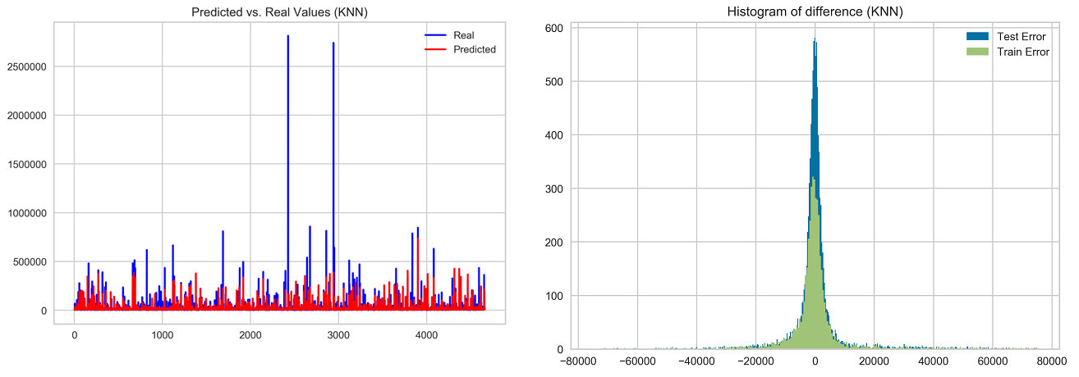
KNN

Slide 18
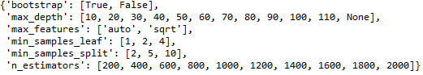
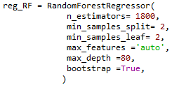
Random Forest
RandomizedSearchCV
Best Parameters

Slide 19
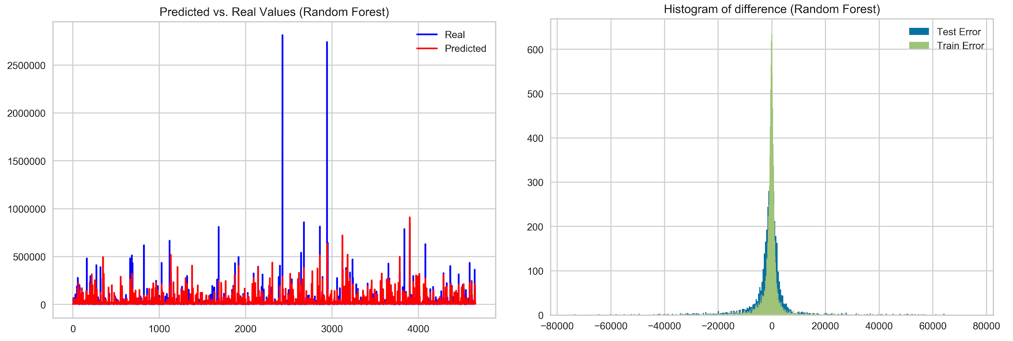
Random Forest

Slide 20
Neural Network

Slide 21
Prediction Conclusion
The best performence for prediction value of the land achieved by Random Forest - RMSE: 59076.

